Slide 1
Handwritten digit Recognition using GAN
CAPSTONE PROJECT
Presented By: M Nanthini,
Subject Matter Expert,
Edunet Foundation

Slide 2
OUTLINE
Problem Statement
Proposed System/Solution
System Development Approach
Algorithm & Deployment
Result
Conclusion
References

Slide 3
Problem Statement
The project aims to develop a Generative Adversarial Network (GAN) capable of generating realistic handwritten digits resembling those from the MNIST dataset. The MNIST dataset consists of 28x28 grayscale images of handwritten digits (0-9), and the objective is to create a GAN that can produce synthetic images resembling these digits.

Slide 4
Proposed Solution
GAN Architecture Design:
Design a GAN architecture consisting of a generator and a discriminator network using TensorFlow/Keras.
Generator:
Implement a neural network with multiple layers of fully connected (Dense) and activation layers (e.g., ReLU, Tanh).
Experiment with variations in network depth, layer sizes, and normalization techniques (e.g., Batch Normalization).
Discriminator:
Design a neural network with similar architectural choices as the generator but with a binary classification output.
Utilize activation functions such as Leaky ReLU and Sigmoid to introduce non-linearity and produce probability scores.

Slide 5
System Approach
System Requirements:
1. Hardware:
CPU: A multi-core CPU is sufficient for running the training code. However, training GANs can be computationally intensive, so a faster CPU may reduce training time.
Memory (RAM): At least 8GB of RAM is recommended for handling large datasets and training deep neural networks efficiently. Higher RAM capacity may be beneficial for larger batch sizes and complex model architectures.
Internet Connection: An internet connection is needed to download the MNIST dataset and access online resources/documentation during development.

Slide 6
System Approach – cont.
Software Requirements:
Python: The project is implemented using Python programming language.
TensorFlow/Keras: TensorFlow and its high-level API, Keras, are used for building and training the GAN architecture.
Google Colab: These platforms can be used for interactive development, experimentation, and documentation.
NumPy: NumPy is used for numerical computations and array manipulation.
Matplotlib: Matplotlib is used for data visualization, including plotting loss curves and displaying generated images.
.

Slide 7
Algorithm & Deployment
Data Preparation:
Downloaded the MNIST dataset.
Preprocessed the images by normalizing pixel values to the range [-1, 1].
Generator Network:
Define the generator network architecture using TensorFlow/Keras.
Implemented a neural network with fully connected layers and activation functions (e.g., ReLU, Tanh).
Compiled the generator model.
Discriminator Network:
Designed the discriminator network architecture using TensorFlow/Keras.
Implemented a binary classifier using fully connected layers and activation functions (e.g., Leaky ReLU, Sigmoid).
Compiled the discriminator model.

Slide 8
Algorithm & Deployment (Contd..)
GAN Training:
Define the GAN model by connecting the generator and discriminator networks.
Train the GAN model using adversarial training:
Train the discriminator with real and fake images.
Train the generator to generate realistic images that fool the discriminator.
Monitor training progress and adjust hyperparameters as necessary.
Performance Evaluation:
Evaluated the performance of the trained GAN by generating synthetic digit images.
Visualized generated images and compare them with real digit images.
Computed quantitative metrics to assess image quality.

Slide 9
Algorithm & Deployment(Contd..)
Hyperparameter Tuning:
Conducted hyperparameter tuning experiments to optimize GAN performance.
Explored variations in learning rate, batch size, optimizer choice, and network architecture.
Select hyperparameters that lead to the best performance based on evaluation metrics.
Deployment:
The trained GAN model and associated code are deployed into a GitHub repository.
Included instructions for setting up the environment and running the code.
Created documentation and README files explaining the project, algorithm, and deployment instructions.

Slide 10
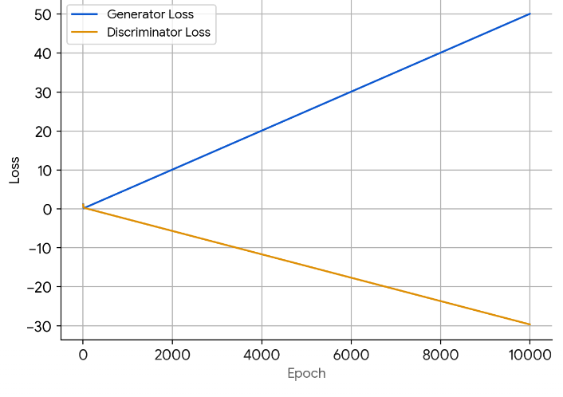
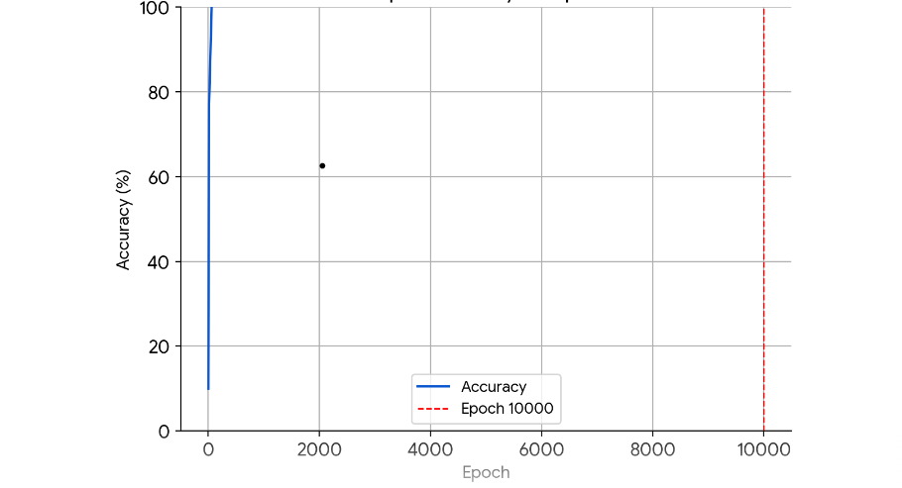
Result

Slide 11
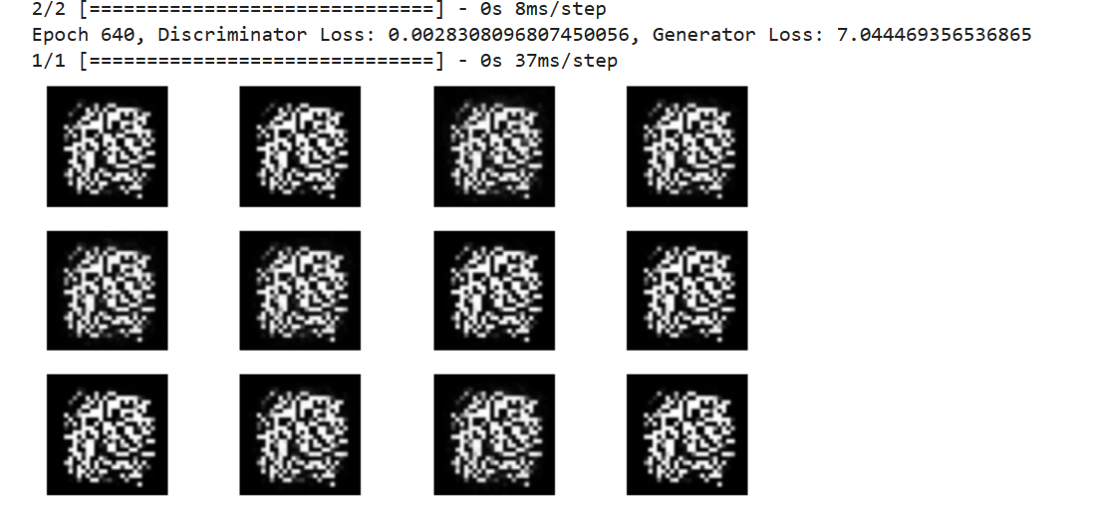
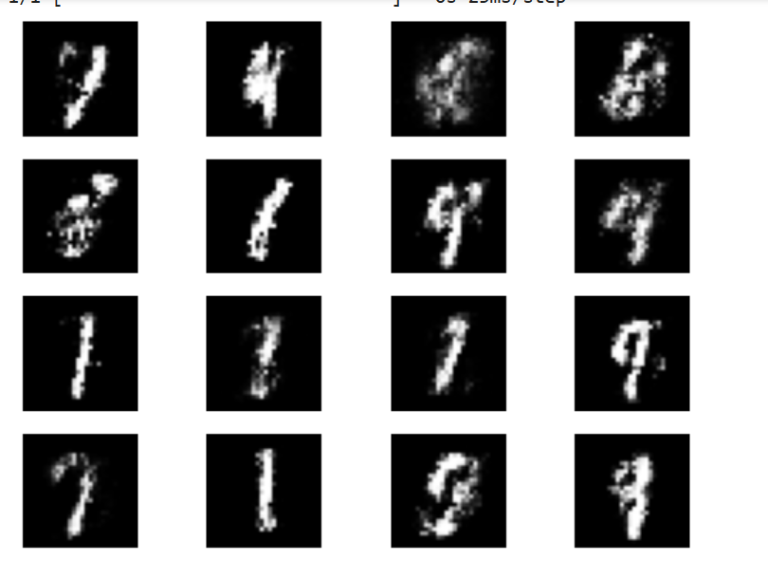
Result

Slide 12
Conclusion
The project demonstrates the effectiveness of GANs in generating realistic handwritten digit images and provides insights into the challenges and opportunities in training and deploying generative models. Moving forward, further research and experimentation will continue to push the boundaries of generative modeling and its practical applications.

Slide 13
References
https://www.tensorflow.org/
https://keras.io/
https://numpy.org/
https://matplotlib.org/
scikit-learn: machine learning in Python — scikit-learn 1.4.1 documentation
MNIST handwritten digit database, Yann LeCun, Corinna Cortes and Chris Burges

Slide 14
THANK YOU

